Slide 1
K4: FACILITATION
The Secret to Successful Meetings!
Carol A. Watson, Director of the Law Library
Wendy E. Moore, Acquisitions Librarian
Alexander Campbell King Law Library
University of Georgia School of Law
AALL 2010 Denver
July 13, 2010, 3:30-4:00 p.m.
Notes:
Welcome to the last session of AALL 2010!
Introduce ourselves

Slide 2

Notes:
Who here loves meetings?
We all attend meetings. We all have to lead meetings at some point.
There are many kinds of meetings: planning, reporting, administrative, decision-making, brainstorming, sometimes all of the above. Some meetings are better than others – the secret lies in how these successful meetings are facilitated.

Slide 3
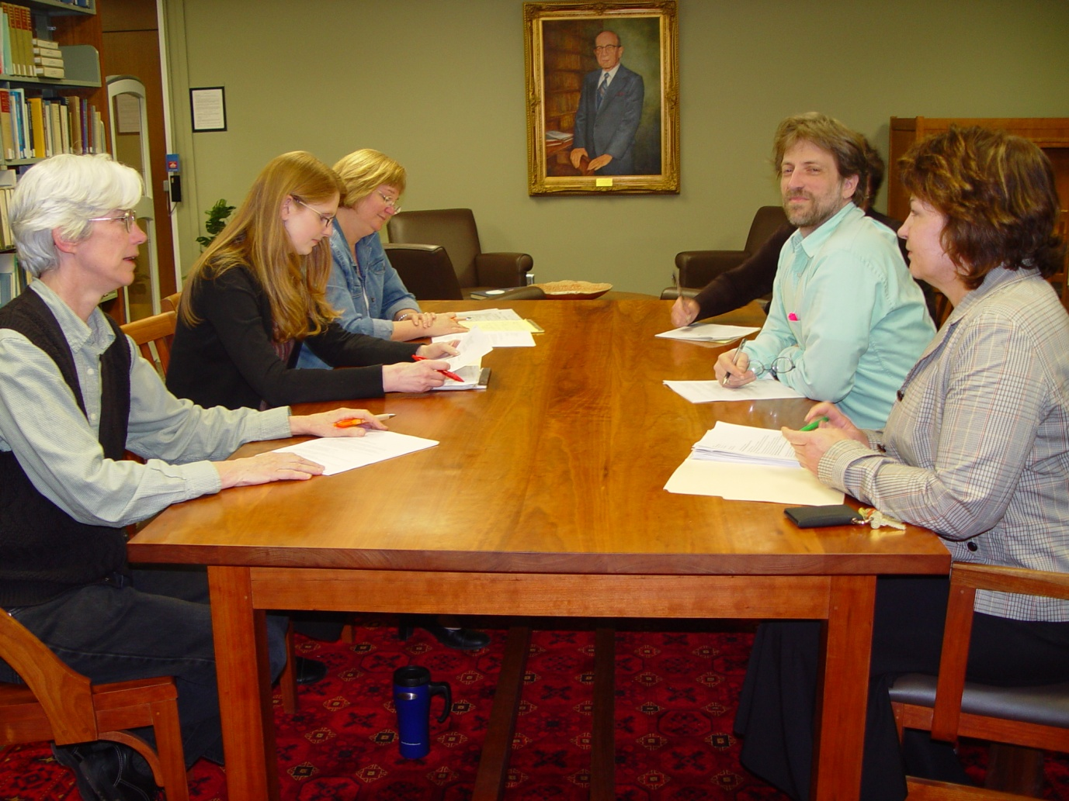
Facilitating = Guiding
Notes:
Facilitating is not about doing trust exercises or putting ideas on a flip chart (although you could do those things) – Facilitating is about successfully guiding a group of people through the process of acting on the tasks that need to be addressed by the group. And guess what? While facilitating a meeting is easier when you are leading it, even if you are just an attendee, you can still use the secrets of facilitation to improve the meetings you attend.

Slide 4

FOUNDATION
Notes:
Foundation
Prepare, prepare, prepare.
One of the most important things you can do
Key items are:
Agendas
Ground rules
Meeting spaces

Slide 5
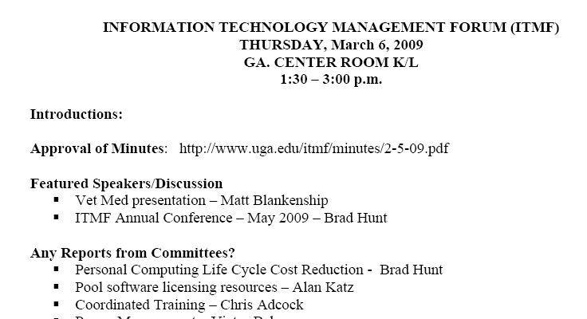
Agendas
Notes:
Agendas
You have to have an agenda for your meeting
no matter how regular or informal or small
AND it must be made available to attendees (or even others!) ahead of time
WITH supporting documentation
Don’t forget: include date, time (especially the ending time) and location
WM: We could do a whole workshop just on agenda development.

Slide 6
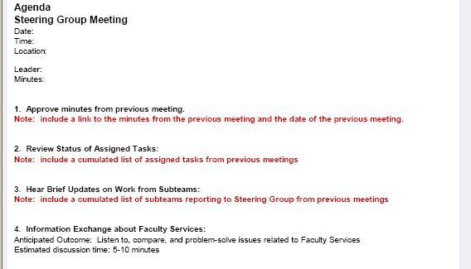
Agenda Template
Notes:
Develop an agenda that meets the group’s needs.
It doesn’t have to be the traditional “reports-old business-new business” format – probably better if it isn’t!
In fact, you may want to establish an agenda template for regular meetings of the same group
WM: Explain example

Slide 7
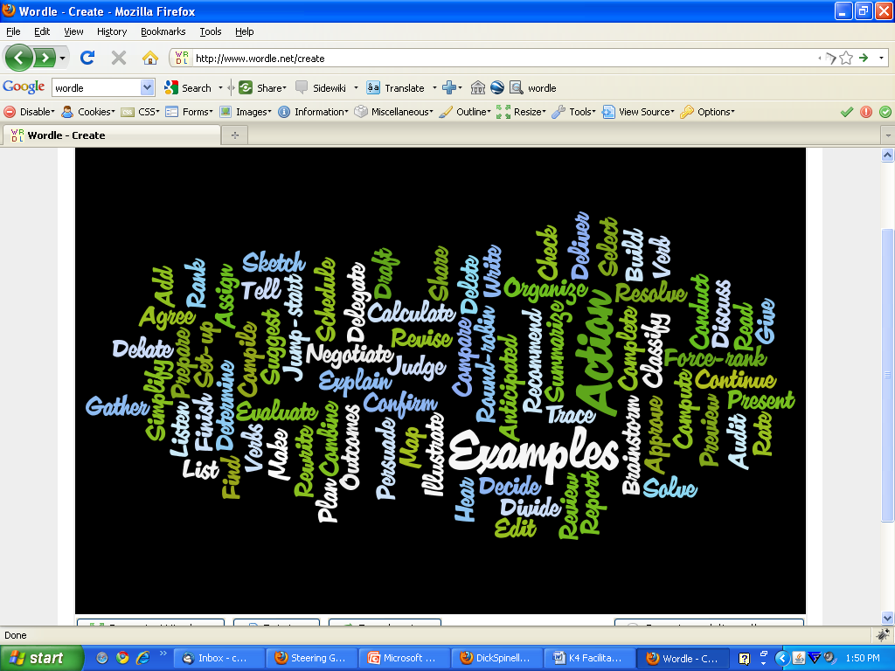
Use Action Verbs
Notes:
Use meaningful action verbs for your agenda items.
Can take some extra work, but is very helpful in directing the course of discussion on an agenda item.
List of suggested action verbs is available in your handout. Don’t try to read the “wordle.”

Slide 8
Poor | Better
Sohn Library Usage | Review and approve a Sohn Library Usage Policy
Retreat Planning | Schedule date for retreat and brainstorm discussion topics
Serials Solutions Update | Share status of Serials Solutions implementation and give a description of how it will look in GAVEL
Anticipate Outcomes
Notes:
Establish desired outcomes as part of the agenda.
This is very important for meetings that involve decision-making, brainstorming, and planning
Knowing what is trying to be achieved ahead of time helps people prepare for the meeting
Helps to keep your meeting on track.

Slide 9
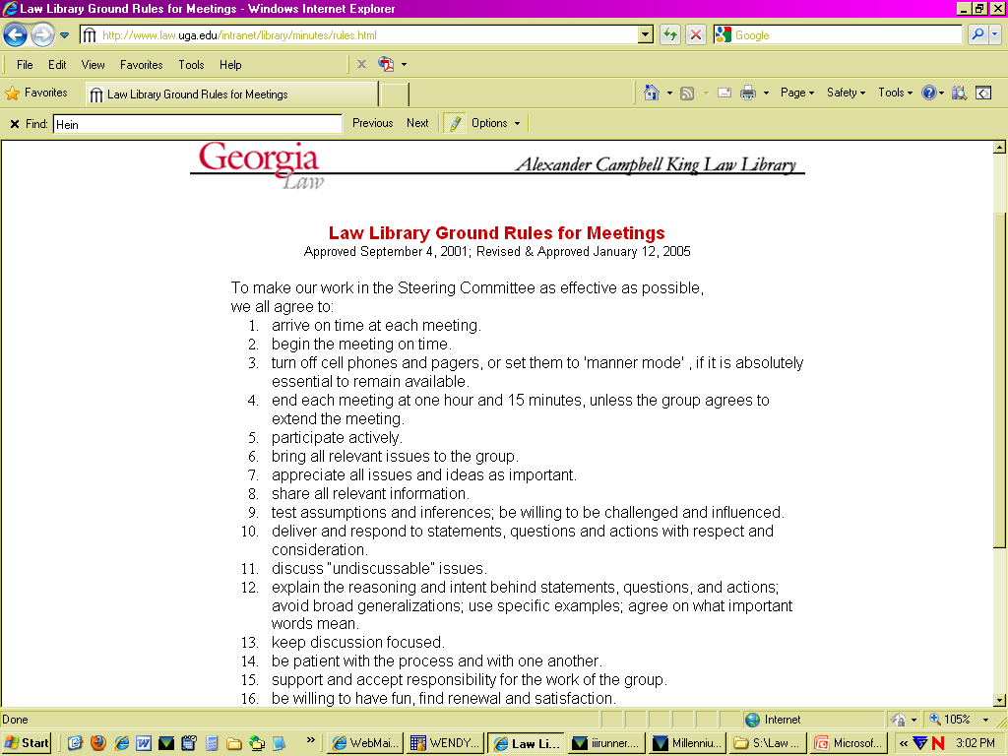
Ground Rules
Notes:
Ground Rules
Ground Rules make facilitating a meeting much easier, because then everyone is coming to the meeting knowing what is expected of them. Have a separate meeting to establish written meeting ground rules for your library or department.

Slide 10
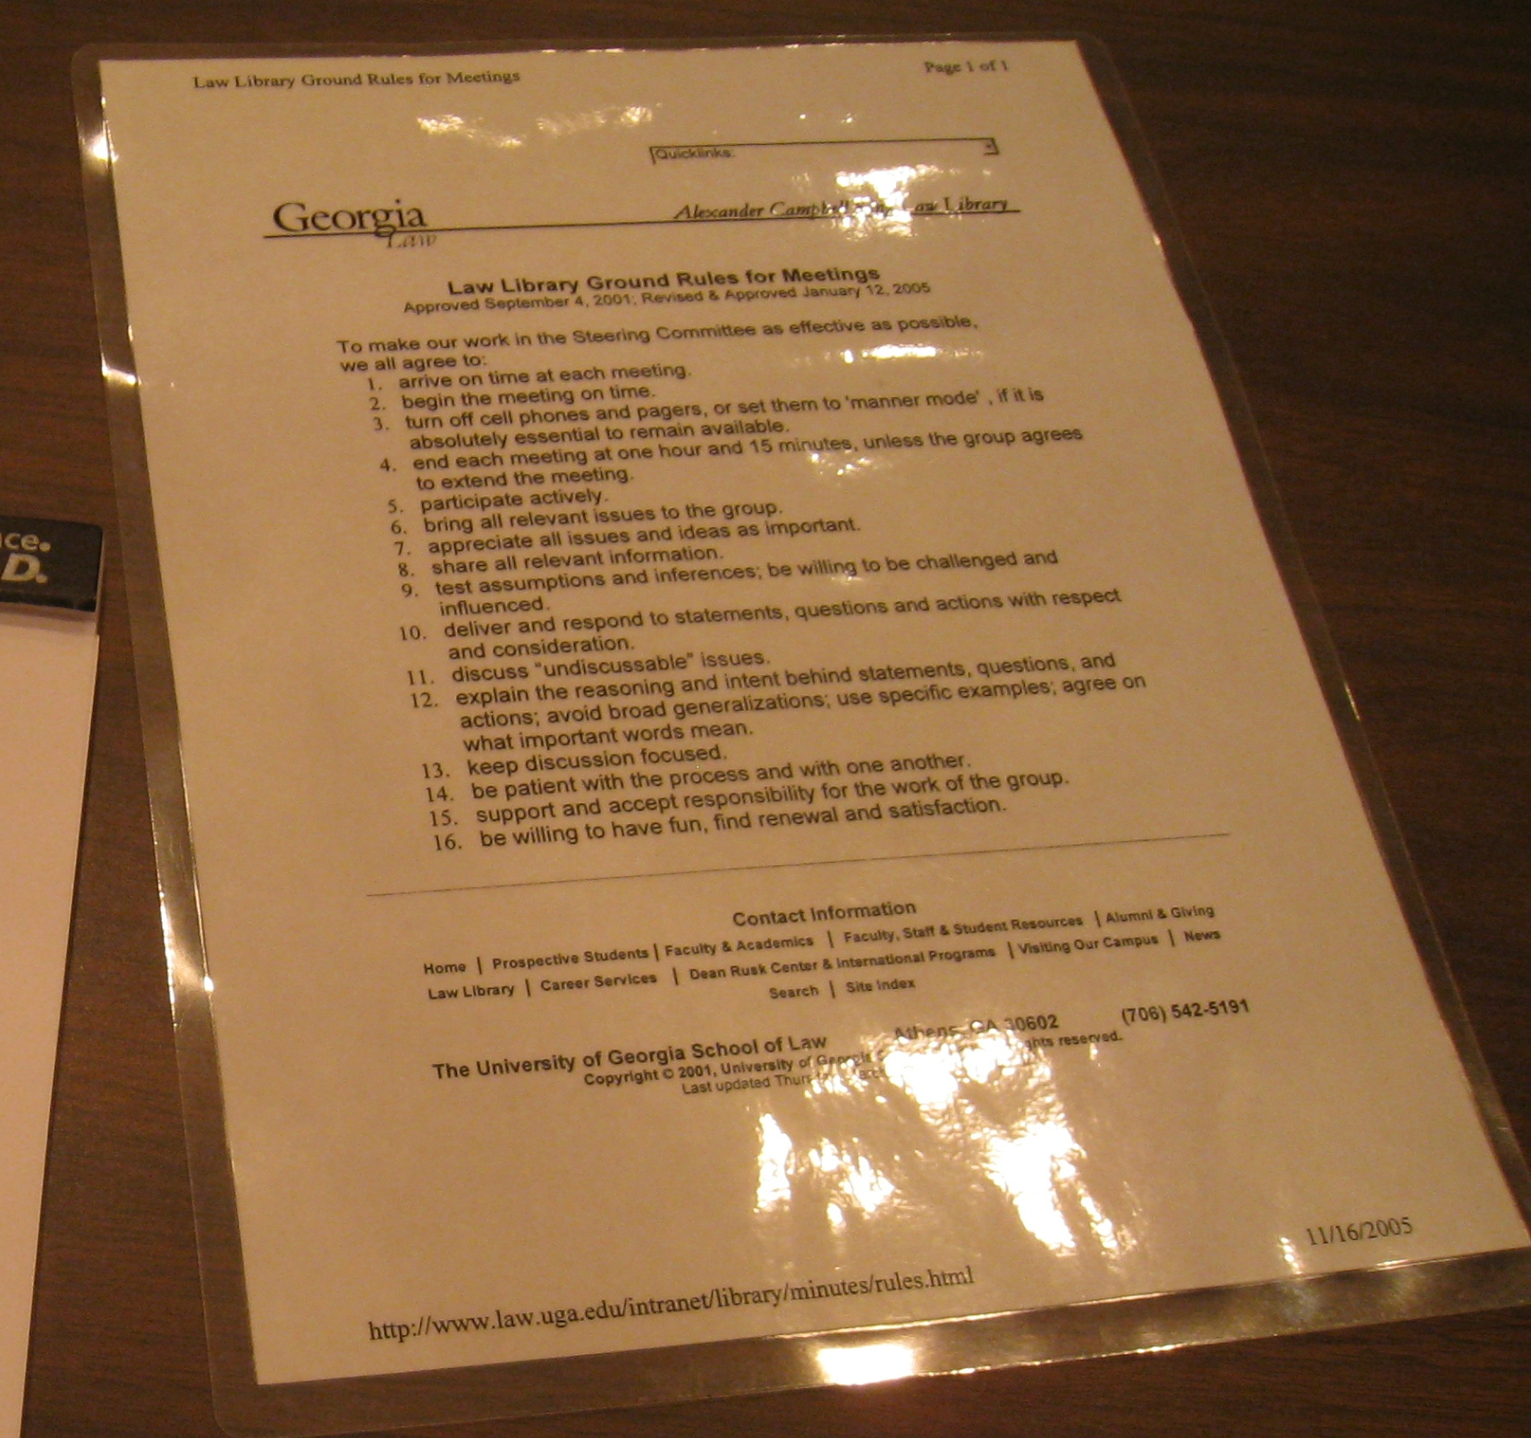
Notes:
The ground rules should not be just a list of don’ts, but rather a list of agreed upon behaviors that will encourage respect and participation in meeting attendees.
<click> Wendy’s favorite is number 14: be patient with the process and with one another.
<click> Carol’s favorite is number…
Our library has two sets of ground rules:
The ones you see here are the very detailed ground rules used by our Library Steering Group (made up of the librarians).
<click>Two laminated copies of these ground rules are placed on the table at the start of our biweekly meetings.

Slide 11
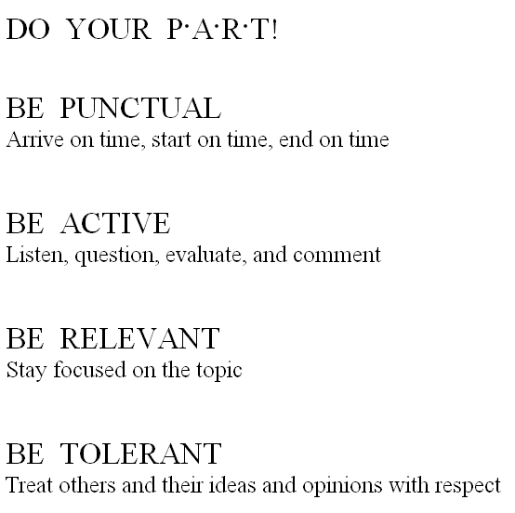
Notes:
The second version is this consolidated version developed by a library staff member to make the ground rules more user-friendly. Annually we take time at a general staff meeting to go over these ground rules and to recommit ourselves to them. Do Your PART!

Slide 12
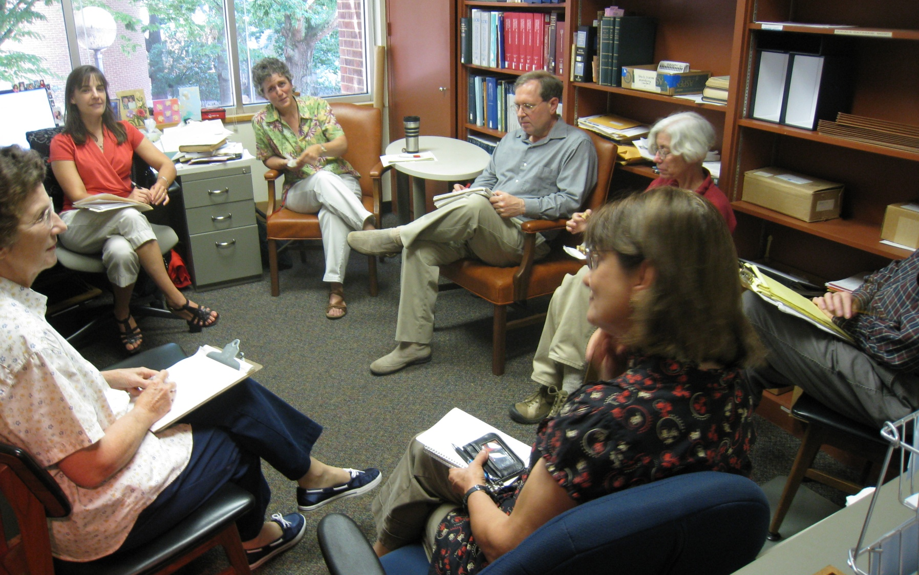
Meeting Spaces
Notes:
Meeting Spaces
How you arrange yourselves as a group can increase meeting effectiveness. Select a space that will permit participants meet in a circular or U-shaped arrangement. This arrangement allows everyone to see each other and helps to minimize hierarchy. Also a space that offers some privacy and lack of interruptions will help participants stay focused.

Slide 13
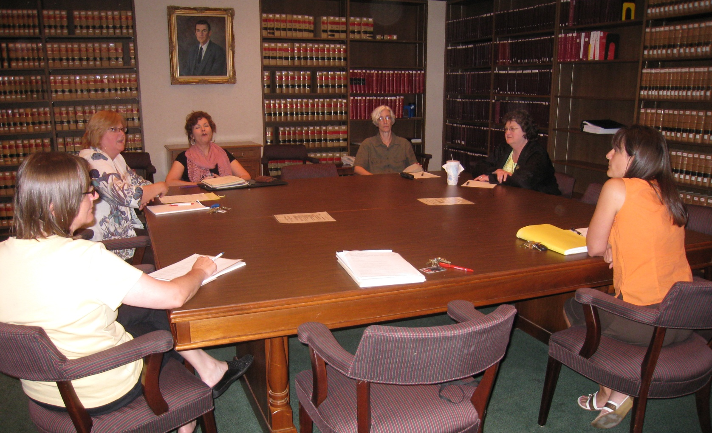
FACILITATION TECHNIQUES
Notes:
Facilitation Techniques
It is time for the actual meeting. What are some practical techniques you can use to make the meeting a positive experience with successful outcomes?

Slide 14
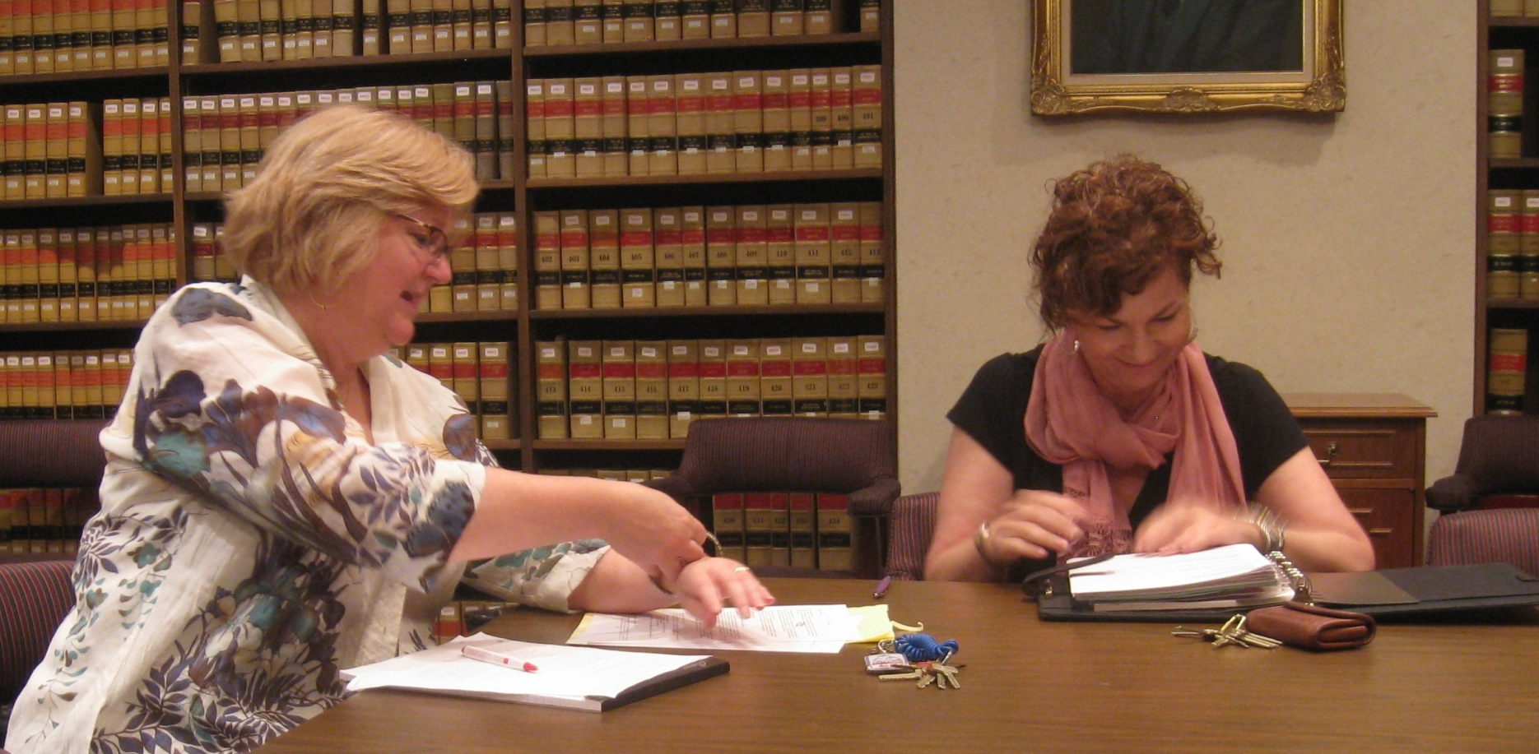
Know what needs to happen at the meeting!
Notes:
Know what needs to happen at the meeting. You have already prepared the agenda, but as the Facilitator you need to be balancing the discussion of the agenda items with the time allotted for the meeting. This means keeping in mind for each agenda item what the importance of it is and what the timeliness of it is. You have to be flexible – one agenda item may run long, but if it is important, and resolution is near, then better to continue with that item and postpone a less important/timely agenda item until the next meeting. Examples:
“It sounds like maybe we need more time to think about how to address this issue. Let’s place this item on the agenda for our next meeting and continue with the rest of today’s agenda.”
“This has been a good conversation and many important considerations have been brought up. I think we can feel good about the progress made on this item. Since our discussion was longer than planned, if everyone agrees, let’s hold agenda item number 6 until the next meeting, since it is not so timely.”

Slide 15
Keep the discussion focused and moving forward!
Notes:
Keep the discussion focused on the agenda topic – you can use the “parking lot” method for new things that come up during discussion – placing those items on a “Future Agenda Items” list or referring to another group/department. That way you don’t ignore the good idea or uncovered problem, but you stay focused on the current agenda item. Example: “Obviously we have a lot of interest and need to talk about X, but let’s put that down as a future agenda item, and go back to the agenda item we are covering now (repeat the agenda item), so we can make progress on it.”

Slide 16
Summarize and Bridge
Notes:
Summarize and bridge conversion to keep it moving forward. As Facilitator you have to ensure that the discussion maintains its form and direction. Periodically during a discussion, you should summarize what has been discussed so far and then use that summary to bridge towards an Action Plan or a decision. Example: “So, we have agreed that we do not want to do X and we have heard the Y approach and the Z approach as options, how do we want to proceed at this point? Do we want to choose approach Y or Z or continue to think about it and place finalizing the approach decision on our agenda for the next meeting?”

Slide 17
Mirroring
Notes:
Mirroring is a technique that you can use to help clarify discussion and keep the conversation moving forward. Sometimes people have a hard time expressing themselves or others have a hard time understanding a point. Mirroring can help bring clarity to a discussion. You could say, “This is what I’m hearing you say, that X is unable to do Y, is that what you are saying?” That then gives the speaker a chance to agree or further clarify what they are trying to say. Remember, you are MIRRORING which means you are repeating in a reworded way, not offering your own commentary or passive-aggressive attitude!

Slide 18
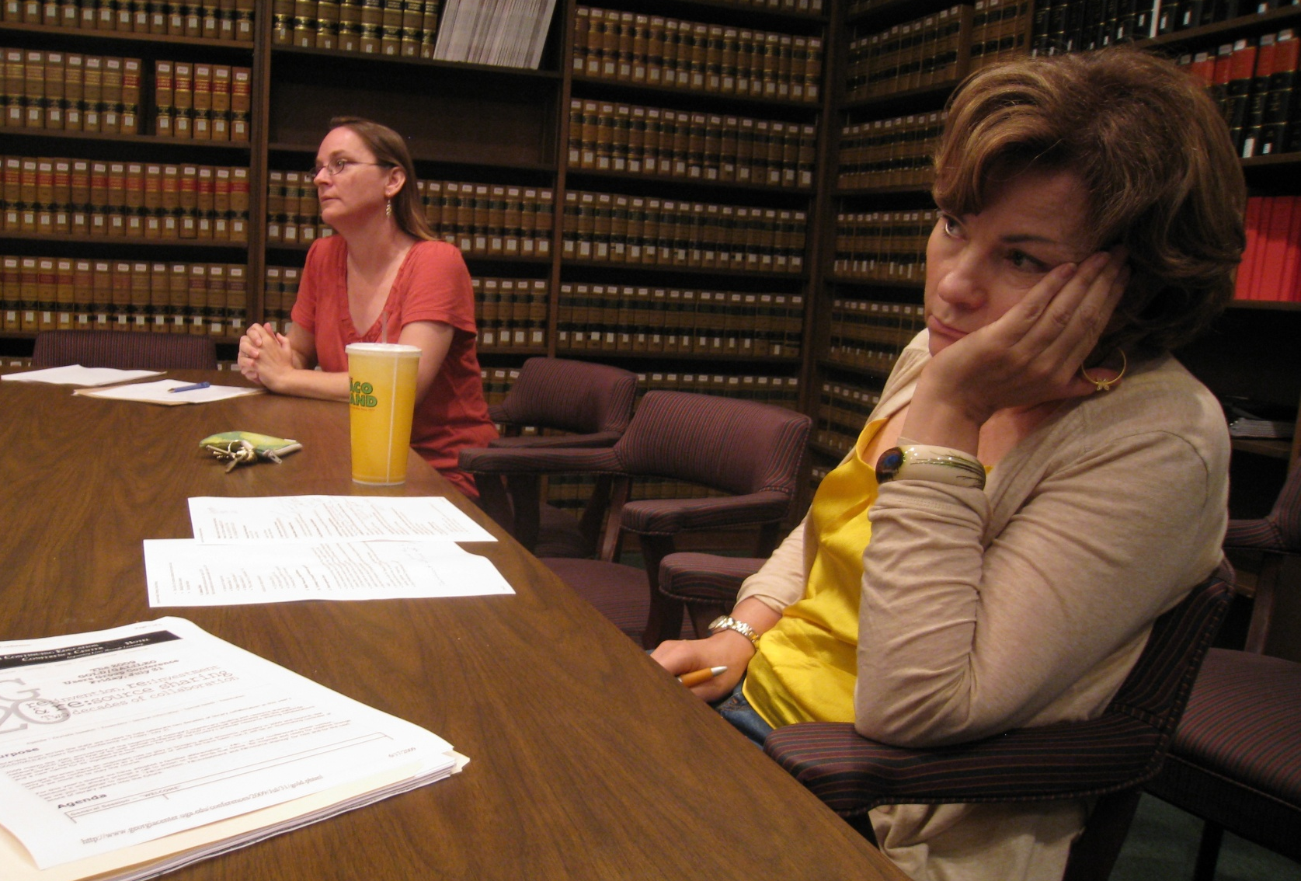
Engage attendees!
Notes:
Engage attendees by asking them for input during discussion of agenda items. May want to try a round-robin technique to ensure you hear from everyone. How to do this? Some examples are:
“Sarah, you haven’t weighed in on this, what do you think is the best approach?”
“We have heard from some of you about the negatives of this proposal, what are some of the positive benefits?”
“We have all had a chance to look over the proposal before the meeting, let’s go around the circle and each share what we saw as its strengths and its areas for concern.”

Slide 19
Agree and Assign!
Notes:
Determine if consensus or resolution of an agenda item is being reached. This can be tricky to do. Using the Summarizing and Bridging techniques can help you figure out if you are ready for an Action Plan or consensus. Not every agenda item resolves itself in one meeting, but at the very least you can try to move the agenda item forward by refining its focus.
Ensure that actions/tasks that come out of an agenda item are agreed upon and responsibilities for them are assigned to individuals, departments, or committees. Example: “To summarize, we have decided that we need more information on X and that John and Sarah will investigate X and will send their info to the group in advance of our next meeting.”

Slide 20
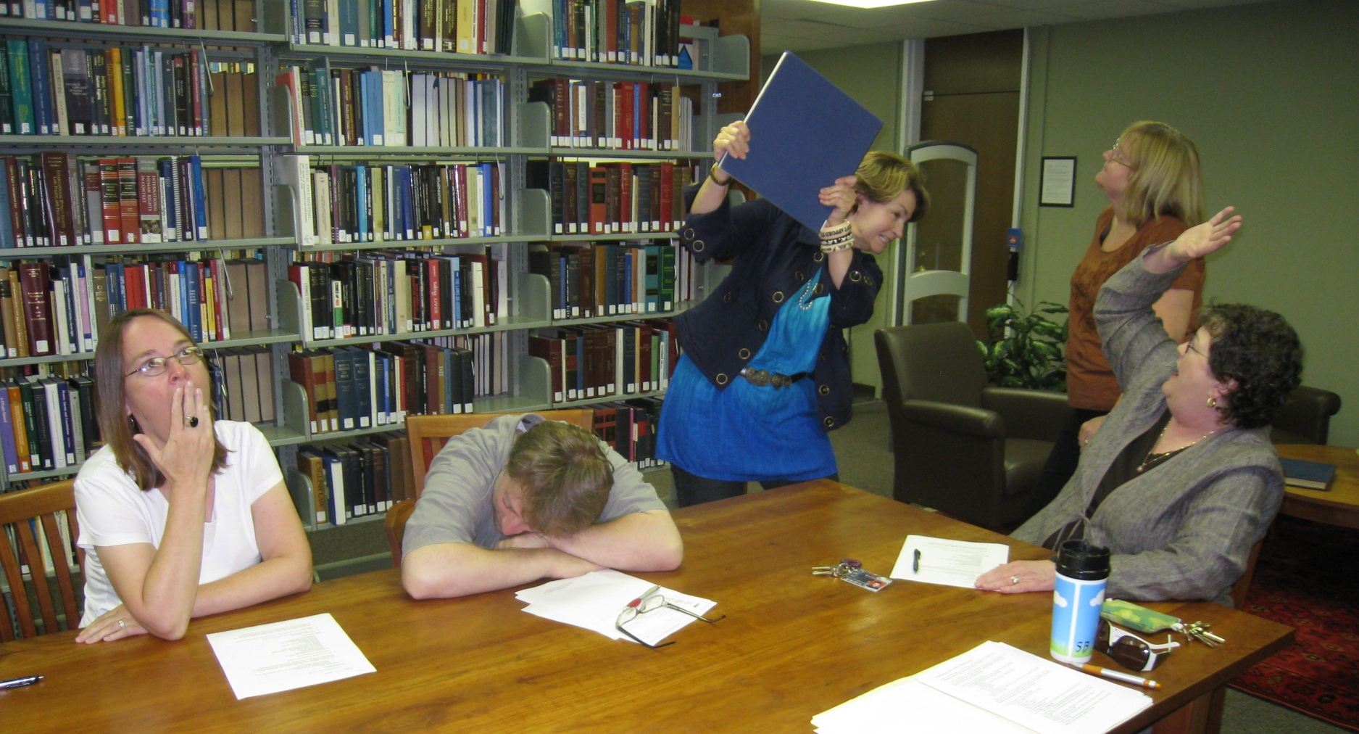

FLY IN THE
OINTMENT
Notes:
Trust me, our library is just as dysfunctional and full of loose-canons as all of yours are.
And yet we have successful meetings with very little behavior issues due to our commitment to the facilitation process and to our ground rules.
So what do you do when problems crop up?

Slide 21
When good discussions go bad…
Off-Topic
Zombies!
Too Long!
Wheels Spinning
Notes:
Off-topic – redirect or cut-off discussion when it goes off topic.
Too much discussion – when a discussion becomes repetitive and there is nothing new being added, then it is time to cut-off discussion and focus on creating an action plan.
Rehashing old topics – can be managed better with written minutes from each meeting. Stay alert to topics that keep coming back as a sign that those topics are not fully resolved and may need to go to the “parking lot” of future agenda items.
Spinning your wheels on a topic – sometimes decisions can’t be reached and there can be good reasons for that, such as philosophical differences, not urgent/important to decide about, or a poorly defined agenda topic. It is o.k. to table an agenda item to give everyone a chance to mull it over and revisit it fresh at the next meeting. You will be surprised how much perspectives have changed. Not a failure = good facilitation.

Slide 22
Too many fires to put out
Notes:
if you find that you are only dealing with immediate problems at meetings, take time to create agenda items that look at larger issues that are more strategic in nature.
Helps reduce the number of small daily problems in the long run
you may need a special meeting

Slide 23
R-E-S-P-E-C-T
Notes:
Call out inappropriate behavior when necessary based on your Ground Rules
such as arriving late or leaving early, whisperers, dropouts, head-shakers, loudmouths.
Usually inappropriate behavior can be redirected, such as a dominating participant can be acknowledged for their contribution, but then solicit others for input or point-of-view.

Slide 24
FINISHING TOUCHES
Notes:
Successful meetings aren’t over when the last agenda item is finished. A well facilitated meeting includes follow-up after the meeting.

Slide 25
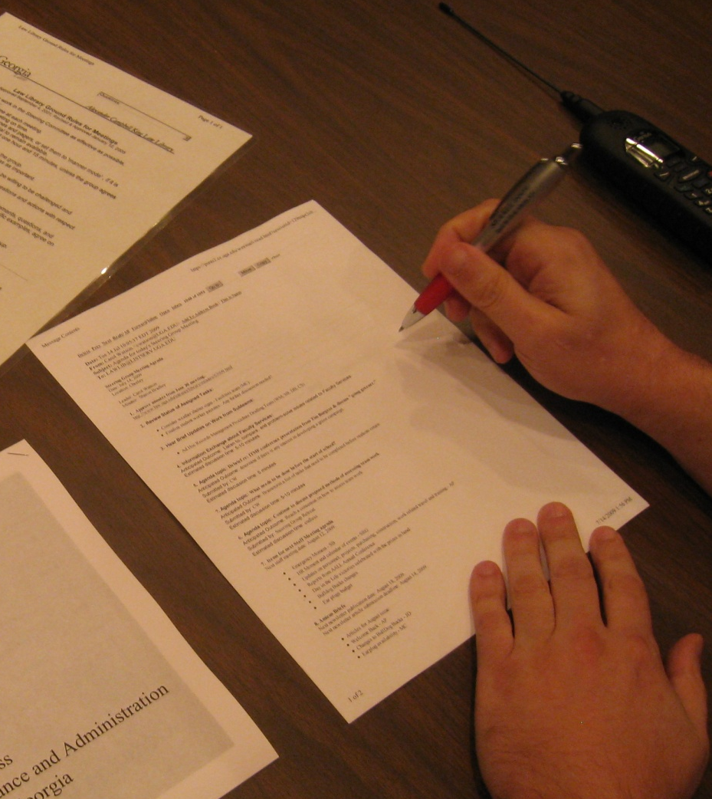
Plan Future Agenda Items
Notes:
Draft Agenda Items for Next Meeting
Make note of any agenda items for the next meeting that came up during the meeting, such as action items that need to be followed up on or new ideas you placed in the “parking lot.”

Slide 26
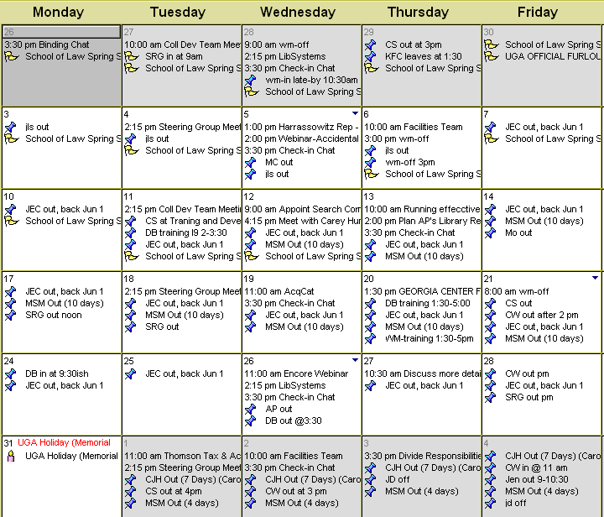
Schedule!
Notes:
Establish Next Meeting
For groups that should meet regularly, establish a schedule of meetings well into the future. This helps limit conflicts and ensures that all members are present.

Slide 27
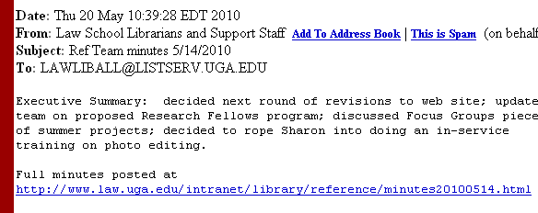
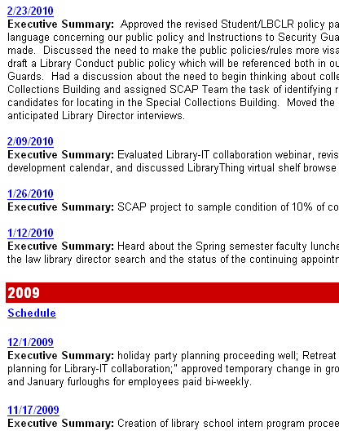
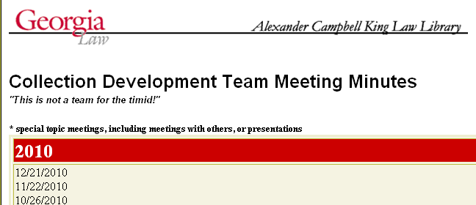
Share the Written Minutes!
Notes:
Distribute and Archive Minutes
People often find meetings to be a waste of time because they make decisions or plans at meetings that never get enacted or they keep having to discuss the same agenda items over and over.
Written minutes that are available in a shared location help document decisions and keep the work of a group moving forward.
Minutes serve to clarify what was decided at a meeting – it is the official version of what happened.
Written minutes also can help to motivate individuals to get work done that has been assigned to them. Depending on the complexity of the meeting, you may want to designate another person to take minutes.

Slide 28
Get Feedback!
Notes:
Get Feedback
Solicit feedback from attendees about what they thought was good about the meeting and what could be improved. Challenge them to think of things they could do to assist in achieving those improvements.

Slide 29
FOUR F’s of FACILITATION
Foundation
Facilitation Techniques
Fly in the Ointment
Finishing Touches
Notes:
When you leave here and go back to work just remember the secret to successful meetings is to focus on the Four F’s of Facilitation: Foundation, Facilitation Techniques, Fly in the Ointment, and Finishing Touches.

Slide 30
THE END!
K4: Facilitation – The Secret to Successful Meetings
Carol A. Watson, Director of the Law Library
cwatson@uga.edu
Wendy E. Moore, Acquisitions Librarian
wemoore@uga.edu
Notes:
The End!

