Slide 1
Survival of the Fittest: Conquering a New Environmental Landscape
Sharon Bradley, Special Collections Librarian
Zanada Joyner, Research and Instructional Services Librarian
Jason Tubinis, Information Technology Librarian
Notes:
ZJ
Welcome to our presentation: Survival of the Fittest: Conquering a new Environmental Landscape
Allow my co-presenters to introduce themselves. Introduce myself.
From our program proposal:
As librarians we, at times, face sweeping changes to the workplace environment. A drastic change in leadership at our institution has ushered in new challenges and opportunities for the law library. The ability to navigate the new landscape requires flexibility, risk-taking, and humility.
Our proposed learning objectives include:
strategies for coping with unforeseen challenges
methods for identifying opportunities in a changing landscape
how to use your existing skills, teams, and resources to their maximum potential in a changing landscape

Slide 2
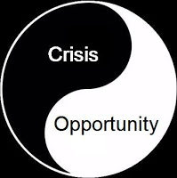
Background
Notes:
JT
Inspiration for this program…
In our workplace there will always be change. The catalyst for change can come from a variety of places: budgetary changes, personnel changes, leadership changes, or organization goals changing. This presentation is borne out of the changes in our institution ushered in by a change in leadership specifically, a new Dean of the Law School.
To navigate the new landscape we need flexibility, risk-taking, and humility.

Slide 3
Change in Leadership
New Law School Dean
Notes:
SB
What had been the reality? “Known constants”
Known constants
Traditional hierarchal model of leadership
Very little cross departmental communication
Efficient system at the status quo
Little pressure to be familiar with social media
No requirement to teach for-credit classes
What were we thinking when the new Dean was chosen
The previous Dean had been the dean for eleven years and the new dean had been a member of the faculty
We were going to maintain the traditional approach.
That’s what alum liked. That’s what faculty wanted

Slide 4
Flexibility
Notes:
JT
In order to operate in a new environment, one must be flexible. There are opportunities for those willing to adapt.
Define flexibility
: capable of bending or being bent
: easily changed : able to change or to do different things
: willing to change or to try different things
Pose the question: Do have examples of how you’ve adapted your in your workplace that you are willing to share?
Thank for responses [move/GSU, leadership, technology, personnel]
Let’s examine a few scenarios of flexibility at our library.

Slide 5
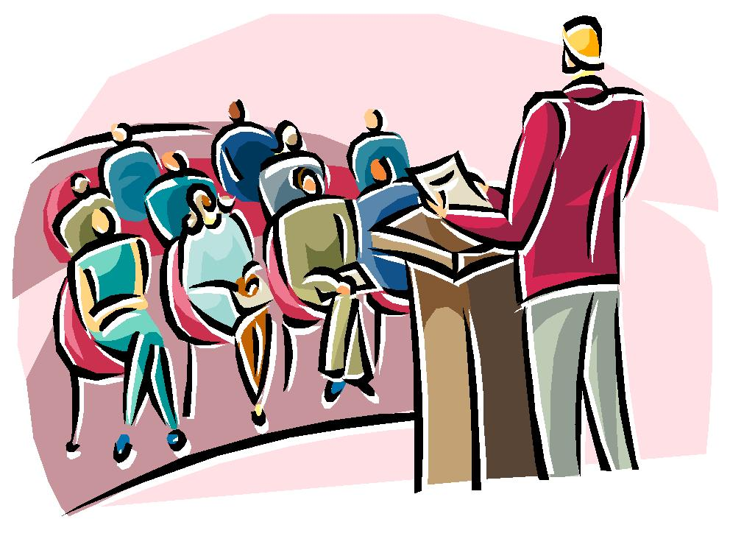
Flexibility Scenario #1
Notes:
JT
Watershed moment – Dean’s Retreat in July 2015
Prior to this our law school operated in silos. Now, our new Dean was asking us to collaborate in ways that were unfamiliar and uncomfortable.
- “Not in Kansas anymore”
Generated a list items to investigate that influenced strategic planning
Awareness of how others in the law school community perceive the library and its services

Slide 6
Flexibility Scenario #2
Notes:
ZJ
Another example of how our library has been flexible in the new environment took place in the Fall 2015. Career Services asked us to collaborate with them on their OCI program. Idea floated as an attempt to work cross-departmentally. The plan was to embed librarians into the on-campus interview program to support the students. Assist students in gathering information about the employer/interviewers.
How does OCI work?
Students and employers “match” and schedule interviews during an even on-campus organized by Career Development.
What we planned to do? Embedding in the OCI break room
Librarians want to be viewed as “team players” in the organization
Set up with laptop for searching of employers, interviewers, and other questions the students might have
Suggest databases where appropriate (Leadership Library)
What actually happened? Librarians passed out snacks, located a hair dryer for a student who was caught in the rain, acknowledge that the student participating were high achieving, motivated students

Slide 7
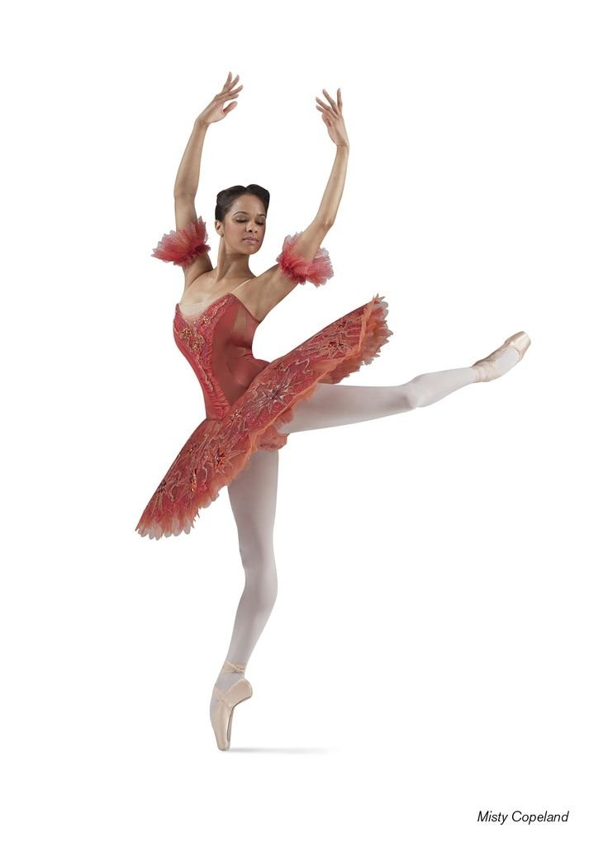
Flexibility Scenario #3
Transformation
Notes:
SB
Discuss the willingness of our director to change responsibilities. Stretching the definition of “Library”
From the Employer viewpoint:
Being flexible signals that you value diversity in the workplace. Diversification of the workplace is the new norm. Differing cultures, religions, and employee needs mean that today’s employer must accommodate diversity when it comes to working, thinking and interacting with others. Being flexible will enable you to accommodate the needs of your diverse workforce more readily.
Flexibility is a good management decision. Managers need to adapt to day-to-day shifts in workplace schedules – employee personal issues, an unexpected influx of work and more. Being flexible creates an environment where employers and employees can look at work and personal needs in a balanced approach, which is mutually beneficial.
Being flexible is a win-win. Being flexible with your employees is good for business. It builds employee trust and commitment, helps attract and keep key talent, as well as drives everyone to find solutions that work for all those involved.
Embracing change can expand your opportunities.
The Library was looking for ways to become more involved in faculty and administrative support.
Cataloging Services librarian transitioned to more competitive intelligence type of research for Development and Admission
Expanding the Research Assistant program so guarantee their hours so we had on-call research assistance for late-breaking faculty requests
Expanding “Special Collections” responsibilities to include working with Development on alumni projects

Slide 8
Notes:
ALL
What might have been a better outcome (existing skills, teams, and resources)
Greater degree of autonomy for some of us which made is harder to communicate with each other. Added a standing item to our management group meeting. Inform the whole Steering Group about Faculty Services, Administrative Services, and Special Collections
Lessons learned:
- ”Try it, no on will die” then evaluate the experience JT
View every opportunity as an “experience” ZJ
See each new project or program initially as an experiment and any experiment can fail. SB

Slide 9
Risk Taking
Notes:
ZJ
Define risk taking
: the act or fact of doing something that involves danger in order to achieve a goal
Pose the question: Do have examples of how you’ve taken risks in your workplace that you are willing to share?
Thank for responses
Let’s examine a few scenarios of flexibility at our library.
Goal that challenges you --- worth the risk
Conditions will never be ideal to take a risk
You must seek that which makes you uncomfortable – try
George Washington Carver “Start where you are, with what you have. Make something of it and never be satisfied”

Slide 10
Risk Taking Scenario #1
Notes:
SB
Portrait collection
Volunteered to be responsible for the school’s portrait collection which included the annual inventory.
Outcome: now seen as the go to person for anything hanging on the walls.
Dean Rusk International Law Center being totally redone after 20 years.
I was just asked to take a few things away for storage but volunteered to catalog, help clean out closets.
Then asked by associate dean to help pick-out frames.

Slide 11
Risk Taking Scenario #2
Notes:
JT
New course topics
* Business law research
* GA research
* ALR
* 1L research
Take away: any proposal needs extensive discussion by everyone, not just those teaching but those who have to take on other responsibilities

Slide 12
Notes:
ALL
What might have been a better outcome (existing skills, teams, and resources)
Those outside the library have little knowledge of our other tasks and responsibilities SB
We make it look too easy
Measure of trust from the school
Take away/Lessons learned JT
Be careful what you wish for
Greater expectations as a results of past results
Greater responsibilities
Taking risks we didn’t realize we were going to take ZJ

Slide 13
Humility
Notes:
SB
Define humility
the quality or state of not thinking you are better than other people : the quality or state of being humble
“There are times when I am so unlike myself that I might be taken for someone else of an entirely opposite character.”
― Jean-Jacques Rousseau, Confessions
Pose the question: Do have examples of how you’ve been humbled in your workplace that you are willing to share?
Thank for responses
Let’s examine a few scenarios of flexibility at our library.

Slide 14
Humility Scenario #1
Notes:
ZJ
Could not absorb the additional responsibilities with the current staffing. As we develop new courses/new opportunities sought out a new member of the library team with instructional experience.
Teaching 1Ls
One-offs in classroom presentations
Advanced research and additional course topics
Distance education
Likewise humbling for me.
Possess some instructional experiences
Lack significant subject knowledge needed for the courses we teach/will teach
Changing the dynamic that had existed for five years

Slide 15
Humility Scenario #2
Notes:
SB
Asked to retrieve a collection of materials in a federal courthouse several hours away. The Dean wanted us to do “something” with them. Travel to view materials without any indication of their condition/usefulness/plan for our library.
My first thought when I saw the material was “What the f …”
Able to create a Process of Preservation program
Develop a plan/program to restore materials and highlight our work to the community
Bragging rights

Slide 16
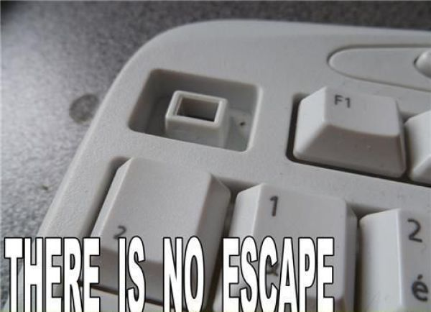
Humility Scenario #3
Notes:
JT
The changes introduced a whole suite of new technology demands, both for the library and for the IT folks:
Distance education
Video production
Support and teach distance education
Ala carte presentation across platforms
Wanted to help support, because these are all really cool, but it was a lot
Part of this involved acknowledging that we couldn’t be the technology gurus we really wanted to be
Fortunately our system administrator is really good at finding alternatives and saying “No” very gently

Slide 17
Notes:
ALL
What might have been a better outcome (existing skills, teams, and resources)
Take away/Lessons learned
Often must perform in the interest of the organization ZJ
Greater good of organization
Blow to the ego JT
There is no substitute for creativity and some bravery in floating a novel proposal. They can’t kill you. Well they can but it’s unlikely. SB
Invite the audience to share:
What have we overlooked?
Acknowledge our cognitive bias

Slide 18
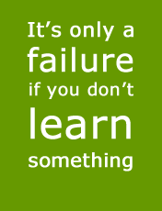
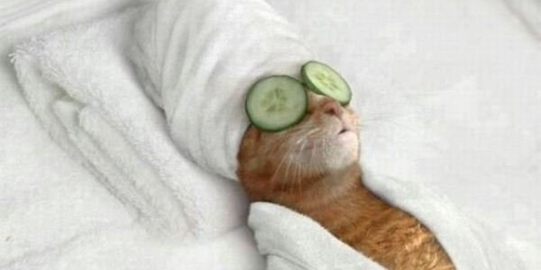
Conclusion
Notes:
ALL
According to the Huffington Post, 83% of American workers are stressed about their jobs. Two things that stress workers: low compensation and unreasonable workload. As such, the
Introspection must be built into embarking on new frontiers
Evaluate what worked and what didn’t; be honest
Objective assessment and subjective assessment
Period of time to “decompress” and then decide if the new challenge was worth the risk

