Slide 1
How Laws are Made:
The Courts

Slide 2
Sharon Bradley
Special Collections Librarian
Alexander Campbell King Law Library
University of Georgia School of Law
bradleys@uga.edu

Slide 3
What we’ll cover
Law, as defined in Black’s Law Dictionary, is “a body of rules of action or conduct prescribed by controlling authority and having binding legal force.” Our laws come from our three branches of Government: legislative, executive, and judicial. These webinars will focus on the law-making activities of each branch, the documents that are created during the process, and how they are used by lawyers and legal researchers.
The Courts interpret statutes, determine constitutionality, and create law as part of our common law system

Slide 4
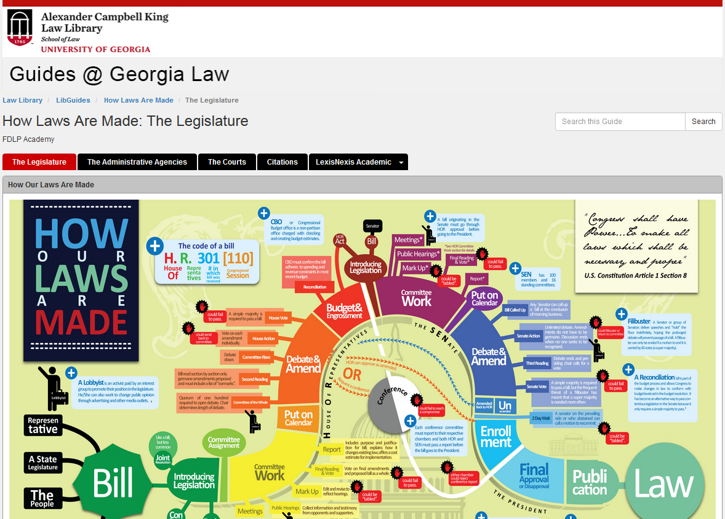
Research Guide
http://libguides.law.uga.edu/fdlp_webinars

Slide 5
Federalism
Central (Federal) Government
Control of external relations (International)
Enumerated powers – Art. I, § 8
Interstate commerce
Coining money
Mail
Piracy
War & Armed Forces
Local (State) Government
Reserved powers
Choice of Law
Cases & Controversies - Art. III, § 2

Slide 6
Separation of Powers
Articles of Constitution
Legislature – Art. I
Executive – Art. II
Judicial – Art. III
Checks and Balances
Avoid encroachment
John Locke & Montesquieu
Sources of Law
Statutes
Regulations
Court Opinions
Constitutions

Slide 7
Judicial Branch
Court Structure
Court of Last Resort (COLR)
Intermediate Appellate Court (IAC)
General Jurisdiction (Trial) Court (GJC)
Federal Structure
Supreme Court (COLR)
Courts of Appeals (IAC)
District Courts (GJC)

Slide 8
Legal Concept - Precedent
Stare decisis
Consistency benefits us all
Allows some predictability
Common law
Hierarchy
Constitution
Statute
Opinions
Regulations

Slide 9
Legal Concept - Authority
Type
Primary
Constitution, Statute, Opinions, Regulations
Secondary
Treatise, Annotation, Law Review Article
Weight
Mandatory
Persuasive

Slide 10
Judicial Opinions
Let’s hope there’s a statute
But the court might still have to interpret the statute
Appellate courts issue published opinions
Opinions
Majority
Dissenting
Concurring
I’ll join you
Plurality

Slide 11
Case Reporters
John B. West
Jurisdictional
Judicial level
Regional
Topical

Slide 12
What Are the Lawyers Doing?
Finding the perfect authority
Filing a Motion – Trial court
Filing a Brief – Appellate court
Arguing that precedent is binding or not
Distinguishing the facts
They are not loopholes or technicalities

Slide 13
Sharon Bradley
Special Collections Librarian
Alexander Campbell King Law Library
University of Georgia School of Law
bradleys@uga.edu

